Slide 1
Binomial Random Variables
Binomial Probability Distributions

Slide 2

Binomial Random Variables
Through 2/24/2011 NC State’s free-throw percentage is 69.6% (146th out 345 in Div. 1).
If in the 2/26/2011 game with GaTech, NCSU shoots 11 free-throws, what is the probability that:
  NCSU makes exactly 8 free-throws?
  NCSU makes at most 8 free throws?
  NCSU makes at least 8 free-throws?

Slide 3
“2-outcome” situations are very common
Heads/tails
Democrat/Republican
Male/Female
Win/Loss
Success/Failure
Defective/Nondefective

Slide 4
Probability Model for this Common Situation
Common characteristics
  repeated “trials”
  2 outcomes on each trial
Leads to Binomial Experiment

Slide 5
Binomial Experiments
n identical trials
  n specified in advance
2 outcomes on each trial
  usually referred to as “success” and “failure”
p “success” probability; q=1-p “failure” probability; remain constant from trial to trial
trials are independent

Slide 6
Binomial Random Variable
The binomial random variable X is the number of “successes” in the n trials
Notation: X has a B(n, p) distribution, where n is the number of trials and p is the success probability on each trial.

Slide 7
Examples
Yes; n=10; success=“major repairs within 3 months”; p=.05
No; n not specified in advance
No; p changes
Yes; n=1500; success=“chip is defective”; p=.10

Slide 8
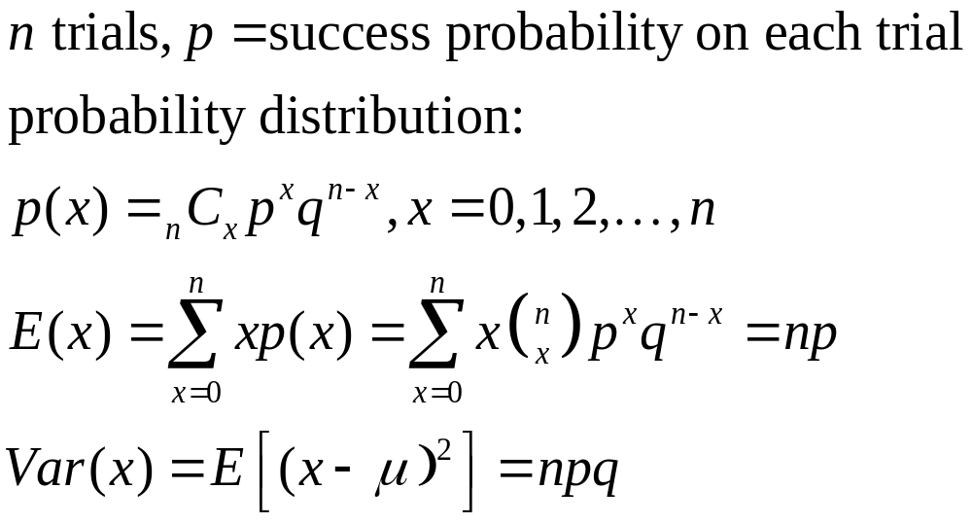
Binomial Probability Distribution

Slide 9
Rationale for the Binomial Probability Formula
n !
P(x) = • p^{x} • q^{n-x}
(n – x )!x!
Number of
outcomes with exactly x successes among n trials
Notes:
The ‘counting’ factor of the formula counts the number of ways the x successes and (n-x) failures can be arranged - i.e.. the number of arrangements (Review section 3-7, page 163).
Discussion is on page 201 of text.

Slide 10
Binomial Probability Formula
n !
P(x) = • p^{x} • q^{n-x}
(n – x )!x!
Number of
outcomes with exactly x successes among n trials
Probability of x successes among n trials for any one particular order
Notes:
The remaining two factors of the formula will compute the probability of any one arrangement of successes and failures. This probability will be the same no matter what the arrangement is.
The three factors multiplied together give the correct probability of ‘x’ successes.

Slide 11
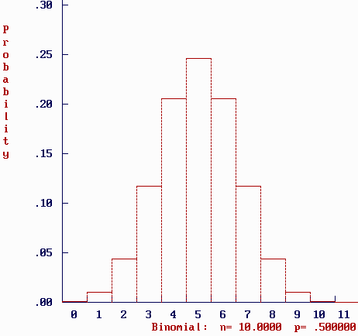
Graph of p(x); x binomial n=10 p=.5; p(0)+p(1)+ … +p(10)=1
Think of p(x) as the area
of rectangle above x
The sum of all the
areas is 1
p(5)=.246 is the area
of the rectangle above 5

Slide 12
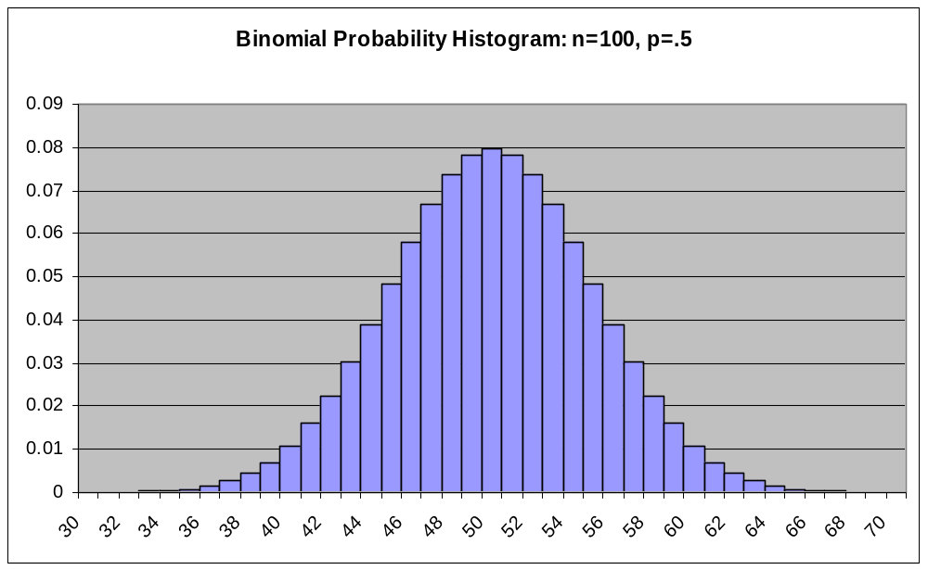

Slide 13
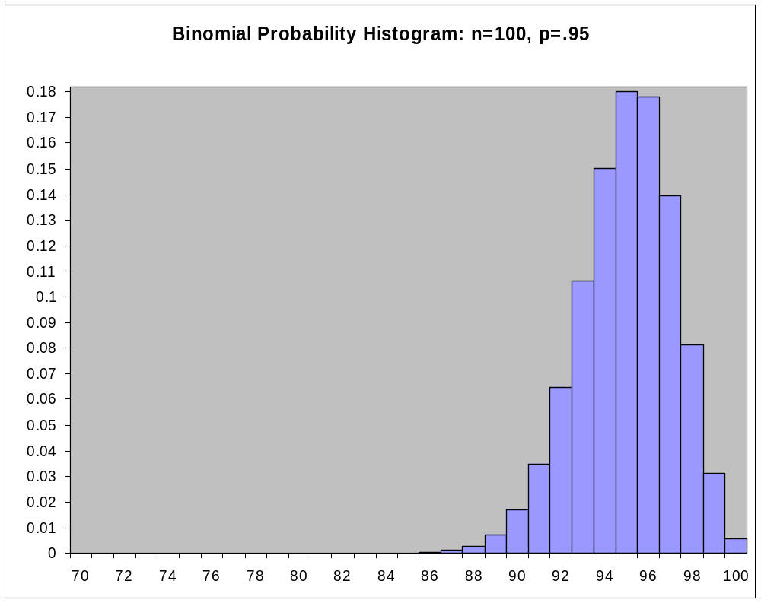

Slide 14
Example
A production line produces motor housings, 5% of which have cosmetic defects. A quality control manager randomly selects 4 housings from the production line. Let x=the number of housings that have a cosmetic defect. Tabulate the probability distribution for x.

Slide 15
Solution
(i) D=defective, G=good
outcome x P(outcome)
GGGG 0 (.95)(.95)(.95)(.95)
DGGG 1 (.05)(.95)(.95)(.95)
GDGG 1 (.95)(.05)(.95)(.95)
: : :
DDDD 4 (.05)⁴

Slide 16
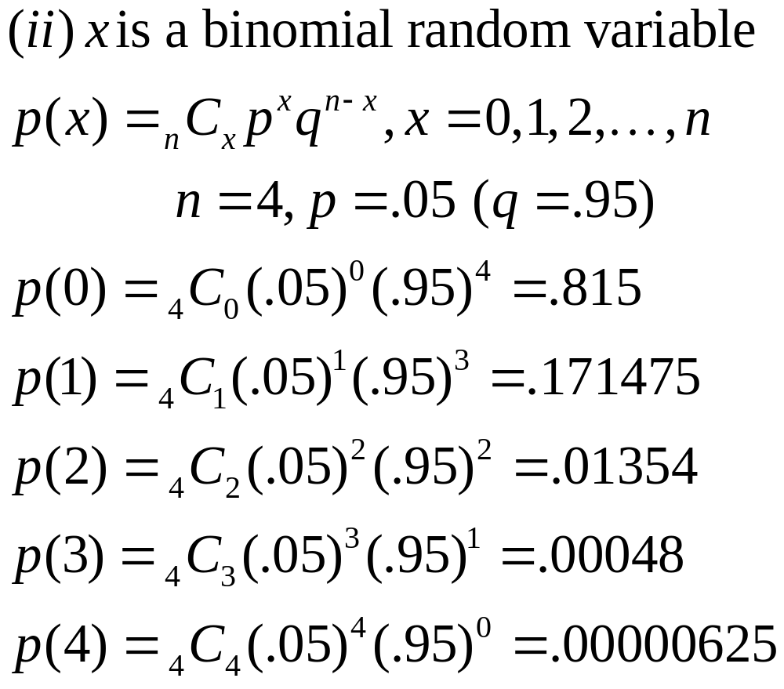
Solution

Slide 17
Solution
x 0 1 2 3 4
p(x) .815 .171475 .01354 .00048 .00000625

Slide 18
Example (cont.)
x 0 1 2 3 4
p(x) .815 .171475 .01354 .00048 .00000625
What is the probability that at least 2 of the housings will have a cosmetic defect?
P(x ≥ 2)=p(2)+p(3)+p(4)=.01402625

Slide 19
Example (cont.)
x 0 1 2 3 4
p(x) .815 .171475 .01354 .00048 .00000625
What is the probability that at most 1 housing will not have a cosmetic defect? (at most 1 failure=at least 3 successes)
P(x ≥ 3)=p(3) + p(4) = .00048+.00000625 = .00048625

Slide 20
Using binomial tables; n=20, p=.3
9, 10, 11, … , 20
P(x ≤ 5) = .4164
P(x > 8) = 1- P(x ≤ 8)= 1- .8867=.1133
P(x < 9) = ?
P(x ≥ 10) = ?
P(3 ≤ x ≤ 7)=P(x ≤ 7) - P(x ≤ 2)
.7723 - .0355 = .7368
8, 7, 6, … , 0
=P(x ≤8)
1- P(x ≤ 9) = 1- .9520

Slide 21
Binomial n = 20, p = .3 (cont.)
P(2 < x ≤ 9) = P(x ≤ 9) - P(x ≤ 2)
= .9520 - .0355 = .9165
P(x = 8) = P(x ≤ 8) - P(x ≤ 7)
= .8867 - .7723 = .1144

Slide 22
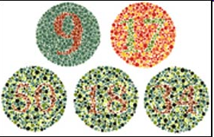
Color blindness
The frequency of color blindness (dyschromatopsia) in the
Caucasian American male population is estimated to be
about 8%. We take a random sample of size 25 from this population.
We can model this situation with a B(n = 25, p = 0.08) distribution.
What is the probability that five individuals or fewer in the sample are color blind?
  Use Excel’s “=BINOMDIST(number_s,trials,probability_s,cumulative)”
  P(x ≤ 5) = BINOMDIST(5, 25, .08, 1) = 0.9877
What is the probability that more than five will be color blind?
  P(x > 5) = 1 − P(x ≤ 5) =1 − 0.9877 = 0.0123
What is the probability that exactly five will be color blind?
  P(x = 5) = BINOMDIST(5, 25, .08, 0) = 0.0329

Slide 23
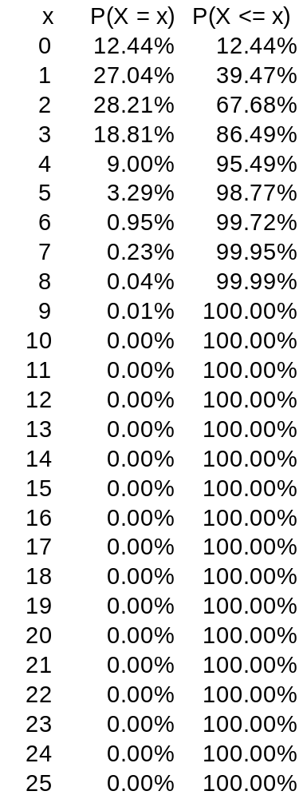
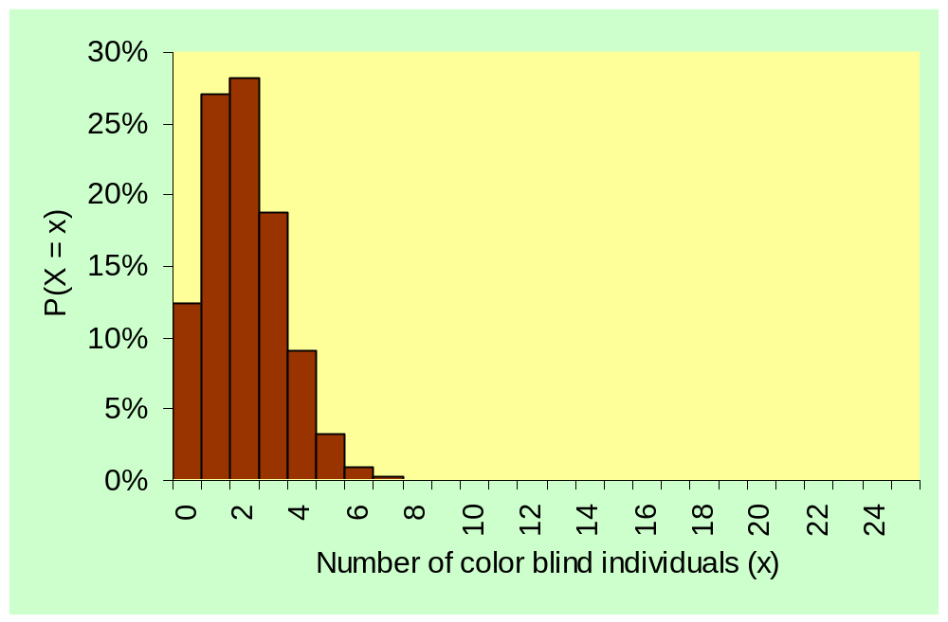
B(n = 25, p = 0.08)
Probability distribution and histogram for the number of color blind individuals among 25 Caucasian males.

Slide 24
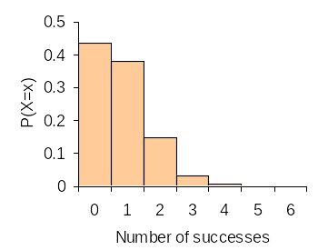
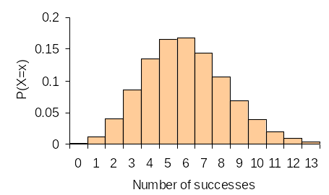
What are the mean and standard deviation of the count of color blind individuals in the SRS of 25 Caucasian American males?
µ = np = 25*0.08 = 2
σ = √np(1 − p) = √(25*0.08*0.92) = 1.36
What if we take an SRS of size 10? Of size 75?
µ = 10*0.08 = 0.8 µ = 75*0.08 = 6
σ = √(10*0.08*0.92) = 0.86 σ = √(75*0.08*0.92) = 2.35
p = .08
n = 10
p = .08
n = 75

Slide 25
Recall Free-throw question
n=11; X=# of made free-throws; p=.696
p(8)= ₁₁C₈ (.696)⁸(.304)³
P(x ≤ 8)=.697
P(x ≥ 8)=1-P(x ≤7)
=1-.4422 = .5578
Through 2/24/11 NC State’s free-throw percentage was 69.6% (146th in Div. 1).
If in the 2/26/11 game with GaTech, NCSU shoots 11 free-throws, what is the probability that:
  NCSU makes exactly 8 free-throws?
  NCSU makes at most 8 free throws?
  NCSU makes at least 8 free-throws?

Slide 26
Recall from beginning of Lecture Unit 4: Hardee’s vs The Colonel
Out of 100 taste-testers, 63 preferred Hardee’s fried chicken, 37 preferred KFC
Evidence that Hardee’s is better? A landslide?
What if there is no difference in the chicken? (p=1/2, flip a fair coin)
Is 63 heads out of 100 tosses that unusual?

Slide 27
Use binomial rv to analyze
n=100 taste testers
x=# who prefer Hardees chicken
p=probability a taste tester chooses Hardees
If p=.5, P(x ≥ 63) = .0061 (since the probability is so small, p is probably NOT .5; p is probably greater than .5, that is, Hardee’s chicken is probably better).

Slide 28
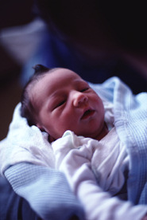
Recall: Mothers Identify Newborns
After spending 1 hour with their newborns, blindfolded and nose-covered mothers were asked to choose their child from 3 sleeping babies by feeling the backs of the babies’ hands
22 of 32 women (69%) selected their own newborn
“far better than 33% one would expect…”
Is it possible the mothers are guessing?
Can we quantify “far better”?

Slide 29
Use binomial rv to analyze
n=32 mothers
x=# who correctly identify their own baby
p= probability a mother chooses her own baby
If p=.33, P(x ≥ 22)=.000044 (since the probability is so small, p is probably NOT .33; p is probably greater than .33, that is, mothers are probably not guessing.

Slide 30
Geometric Random Variables
Geometric Probability Distributions
Through 2/24/2011 NC State’s free-throw percentage was 69.6 (146th of 345 in Div. 1). In the 2/26/2011 game with GaTech what was the probability that the first missed free-throw by the ‘Pack occurs on the 5th attempt?

Slide 31
Binomial Experiments
n identical trials
  n specified in advance
2 outcomes on each trial
  usually referred to as “success” and “failure”
p “success” probability; q=1-p “failure” probability; remain constant from trial to trial
trials are independent
The binomial rv counts the number of successes in the n trials

Slide 32
The Geometric Model
A geometric random variable counts the number of trials until the first success is observed.
A geometric random variable is completely specified by one parameter, p, the probability of success, and is denoted Geom(p).
Unlike a binomial random variable, the number of trials is not fixed

Slide 33
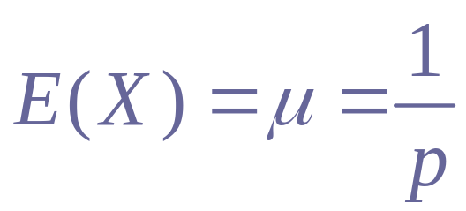
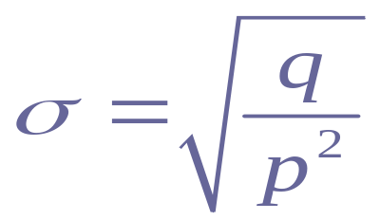
The Geometric Model (cont.)
Geometric probability model for Bernoulli trials: Geom(p)
p = probability of success
q = 1 – p = probability of failure
X = # of trials until the first success occurs
p(x) = P(X = x) = q^{x-1}p, x = 1, 2, 3, 4,…

Slide 34
The Geometric Model (cont.)
The 10% condition: the trials must be independent. If that assumption is violated, it is still okay to proceed as long as the sample is smaller than 10% of the population.
Example: 3% of 33,000 NCSU students are from New Jersey. If NCSU students are selected 1 at a time, what is the probability that the first student from New Jersey is the 15th student selected?

Slide 35
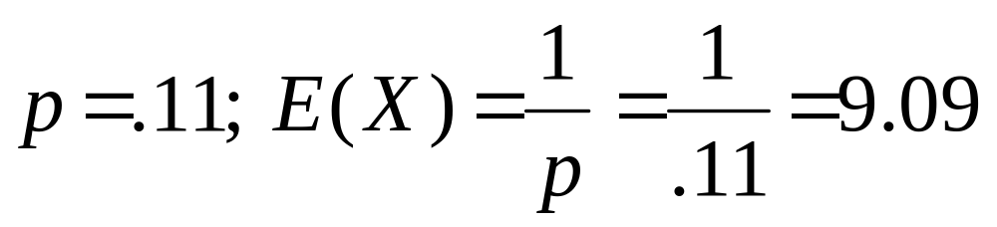
Example
The American Red Cross says that about 11% of the U.S. population has Type B blood. A blood drive is being held in your area.
How many blood donors should the American Red Cross expect to collect from until it gets the first donor with Type B blood?
Success=donor has Type B blood
X=number of donors until get first donor with Type B blood

Slide 36
Example (cont.)
The American Red Cross says that about 11% of the U.S. population has Type B blood. A blood drive is being held in your area.
What is the probability that the fourth blood donor is the first donor with Type B blood?

Slide 37
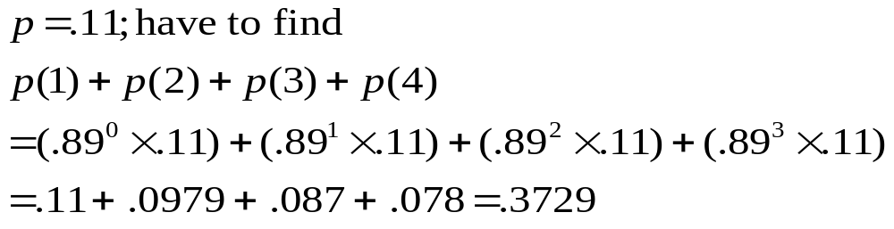
Example (cont.)
The American Red Cross says that about 11% of the U.S. population has Type B blood. A blood drive is being held in your area.
What is the probability that the first Type B blood donor is among the first four people in line?

Slide 38
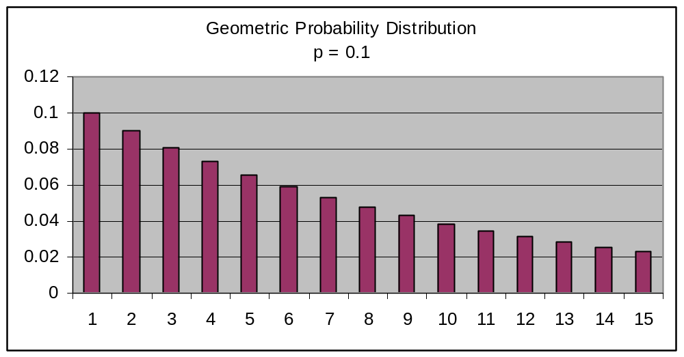
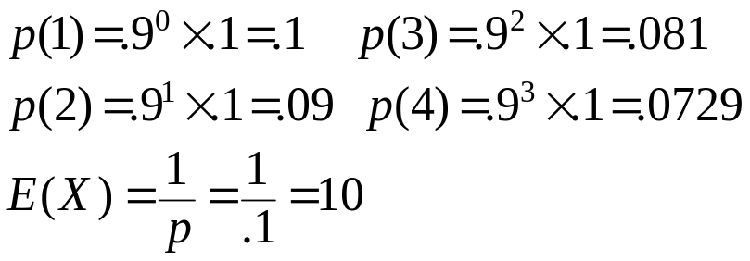

Slide 39
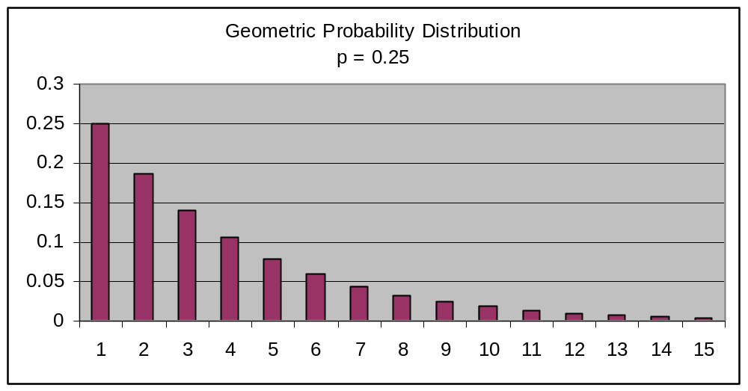
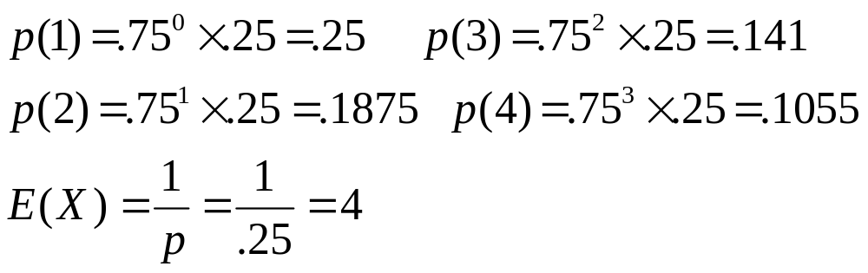

Slide 40
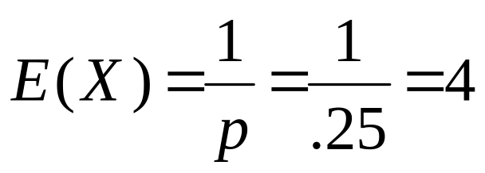
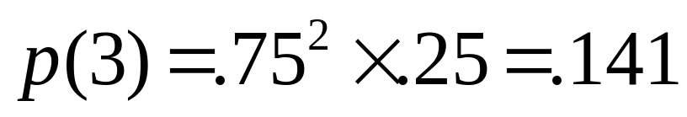
Example
Shanille O’Keal is a WNBA player who makes 25% of her 3-point attempts.
The expected number of attempts until she makes her first 3-point shot is what value?
What is the probability that the first 3-point shot she makes occurs on her 3rd attempt?

Slide 41


Question from first slide
Through 2/24/2011 NC State’s free-throw percentage was 69.6%. In the game with GaTech what was the probability that the first missed free-throw by the ‘Pack occurs on the 5th attempt?
“Success” = missed free throw
Success p = 1 - .696 = .304
p(5) = .696⁴ × .304 = .0713

